Slide 1
Introduction to Unsupervised Learning

Slide 2
Outline
Supervised vs Unsupervised Learning
Clustering
Dimensionality Reduction
Anomaly Detection
Types of unsupervised problems

Slide 3
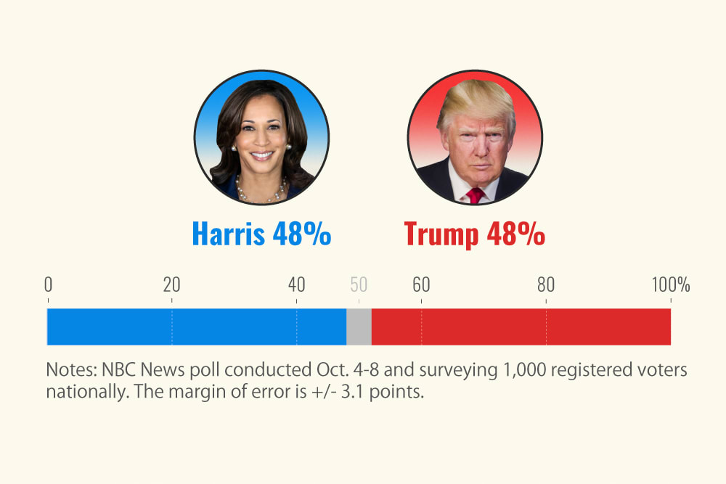
Have you noticed how, during election season, predictions about poll results and candidate leads dominate the news feed?

Slide 4
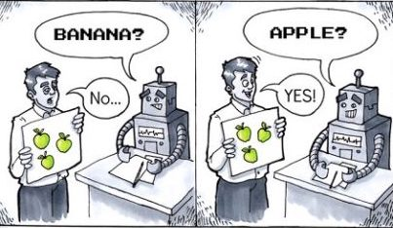
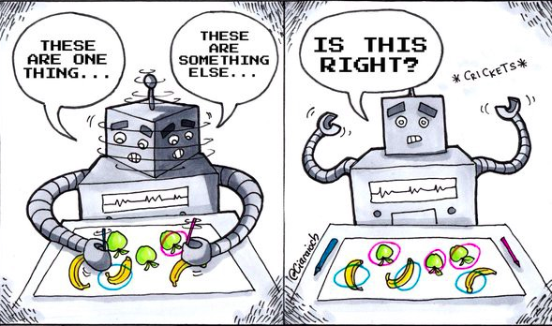
Supervised Learning
Unsupervised Learning

Slide 5



Supervised Learning | Unsupervised Learning
Computer learns by making use of labeled data | Computer learns by making use of unlabeled data
Requires manual annotation of data | Does not require annotation of data
Apple
???
Mango
Grapes
???
???

Slide 6

Rabbit
Koala
Fox
Panda
Pig
Bear

Slide 7
???
???
???
???
???
???

Slide 8


If the data is not labeled, how will the model learn?
????

Slide 9







Group with wings
Group with two legs
Model
Group with four legs

Slide 10
Group with two legs
Group with wings
Group with four legs
Grouping a set of objects in such a way that similar objects fall into the same group.
Method of grouping similar entities together
Similar objects are grouped into one cluster and are different from objects in another cluster.

Slide 11
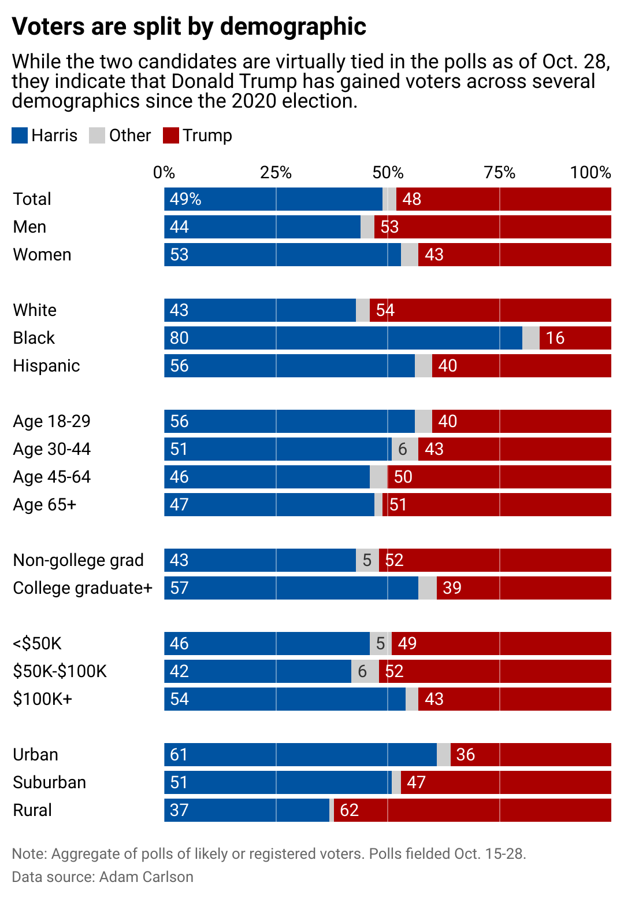
They aren't baseless guesses. They are insights from public opinion surveys, voter turnout models, and a variety of advanced tools and methodologies used in data science.

Slide 12
Even if you've never worked with algorithms or predictive models, you're guaranteed to have encountered data science in your daily life.

Slide 13


Think of every time you've checked election forecasts, seen personalized ads, or simply browsed curated movie recommendations.

Slide 14
That is data science, and it's all around us!

Slide 15
What is Data Science?
The U.S. Census Bureau defines data science as "a field of study that uses scientific methods, processes, and systems to extract knowledge and insights from data."
So, this is a field that works with data that doesn't fit neatly into rows and columns—and, in the end, derives relevant information from it.

Slide 16
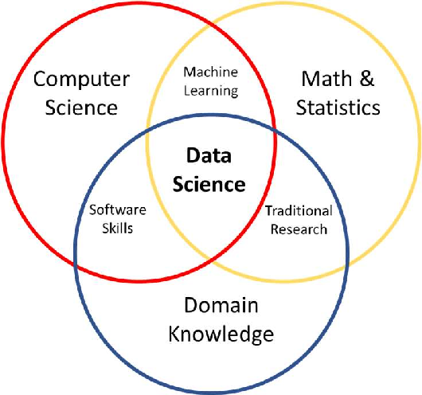
What is Data Science?
Data science is inherently interdisciplinary as it combines expertise from statistics, mathematics, computer science, and domain-specific knowledge.

Slide 17
What is Data Science?
This makes it incredibly versatile, with applications spanning healthcare, finance, marketing, sports, and even solving murder cases.

Slide 18
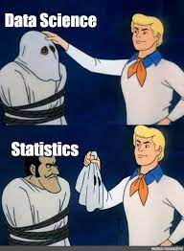
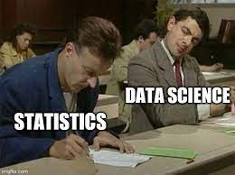
Data Science vs Statistics

Slide 19
Data Science vs Statistics
From history, statistics was the foundation of data science.
However, while statistics focuses on understanding and explaining data, data science takes it a few steps further by using algorithms and computational tools to automate analysis, make predictions, and generate actionable insights.

Slide 20
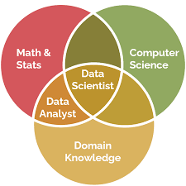
Data Science vs Data Analytics
Data science and data analytics both involve working with data, and the distinction between the two is so unclear that they are often used interchangeably.

Slide 21
Data Science vs Data Analytics
However, the latter is generally seen as a subset of data science since while data science deals with more complex techniques to analyze datasets to make future predictions and automate processes, data analytics tends to focus on interpreting and visualizing the data.

Slide 22
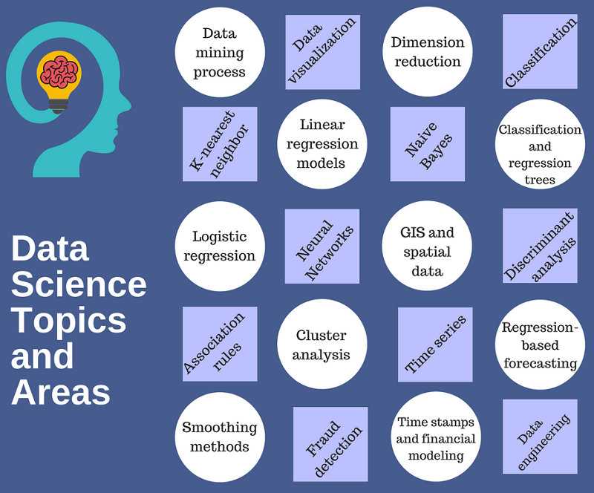
Spectrum of Data Science

Slide 23

How clustering helped tracked a killer

Slide 24




What is Data Science?
Nowadays, there is an overwhelming amount of data generated—millions of terabytes every day.

Slide 25
What is Data Science?
It's often produced through everyday activities like scrolling through social media or buying something online.

Slide 26
What is Data Science?
Each action leaves behind bits of information, like breadcrumbs, that systems gather and hold onto.

Slide 27
What is Data Science?
But here's the thing: all this information doesn't come neatly organized and ready to work with.
At first, it's just a chaotic mix of numbers, texts, and signals that need to be sorted and shaped into something meaningful before it's actually useful.

Slide 28
What is Data Science?
Therefore, the purpose of data science is to work with some of that data and drive better-informed decision-making.

Slide 29
Outline
What is Data Science?
Data Science Life Cycle
Tools and Technologies
Core Techniques
Career Opportunities

Slide 30




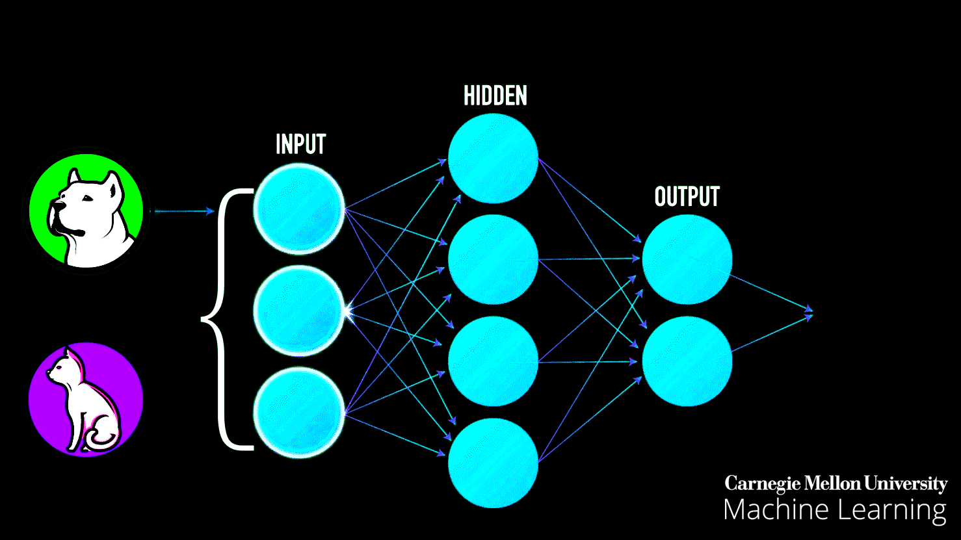
The Data Science Life Cycle
Collect Data
Clean Data
Explore Data
Model Data
Interpret Data

Slide 31
The Data Science Life Cycle
Collect Data
Clean Data
Explore Data
Model Data
Interpret Data

Slide 32
The Data Science Life Cycle
Collect Data
Clean Data
Explore Data
Model Data
Interpret Data

Slide 33
The Data Science Life Cycle
Collect Data
Clean Data
Explore Data
Model Data
Interpret Data

Slide 34
The Data Science Life Cycle
Collect Data
Clean Data
Explore Data
Model Data
Interpret Data

Slide 35
Collecting Data
The first step in the data science life cycle is obtaining the data.
Data scientists can collect data from a variety of sources, including databases, sensors, APIs (application programming interfaces), and online platforms.

Slide 36
Collecting Data
At this stage, the most important thing is ensuring that you have the right information to work with.
So, you should gather data that is relevant to the problem you're trying to solve to avoid wasting time and effort with all the other steps that follow.

Slide 37
Cleaning Data
After the data is collected, data scientists clean and preprocess it.
This step, often referred to as data cleaning or wrangling, requires data scientists to format the data for analysis and deal with missing values, duplicates, and other errors.

Slide 38
Cleaning Data
Data scientists spend a significant portion of the cycle at this stage, as cleaning and preparing the data guarantees that it will be both usable and reliable—key prerequisites for achieving good results.

Slide 39
Exploring Data
At this stage, the data is ready, so data scientists begin the so-called exploratory data analysis (EDA) process. The aim is to understand the data's underlying structures and main characteristics and identify patterns.

Slide 40
Exploring Data
The goal is to better understand the data and develop hypotheses to guide model building or further analyses.

Slide 41
Modeling Data
Next, data scientists use machine learning algorithms or different statistical techniques in order to predict outcomes or explain relationships within the data.

Slide 42
Modeling Data
Depending on the problem, these models can be predictive, such as forecasting future sales, or descriptive, such as clustering customers by behavior.

Slide 43
Interpreting Data
If all previous steps are done correctly, data scientists should have produced results by the end of the cycle, and all that is left to do is interpret the conclusions and communicate them to the rest of the team.

Slide 44
Interpreting Data
Communication plays a huge role at this stage, as all insights should be presented in a clear and concise manner so that stakeholders can understand them and be able to use them to aid decision-making.

Slide 45
Outline
What is Data Science?
Data Science Life Cycle
Tools and Technologies
Core Techniques
Career Opportunities

Slide 46


Data Science Tools and Technologies

Slide 47

Data Science Tools and Technologies

Slide 48



Data Science Tools and Technologies

Slide 49
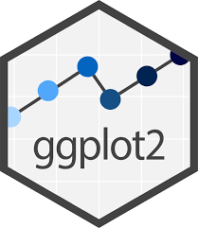



Data Science Tools and Technologies

Slide 50



Data Science Tools and Technologies

Slide 51
Outline
What is Data Science?
Data Science Life Cycle
Tools and Technologies
Core Techniques
Career Opportunities

Slide 52
Descriptive Analysis
This kind of analysis focuses on summarizing and describing a dataset's main features through averages, percentages, and frequencies. An example would be a retail company analyzing customer data to determine the average spending per customer.

Slide 53
Diagnostic Analysis
Data scientists working in hospitals could use diagnostic analysis to investigate data and find out factors that lead to higher patient readmission rates in a specific department. The goal is to understand the causes of certain outcomes or trends.

Slide 54
Predictive Analysis
By applying statistical models like regression or classification algorithms, data scientists can predict what is likely to happen in the future. For example, a company might use predictive analysis to estimate future sales or anticipate customer behavior based on past data patterns.

Slide 55
Prescriptive Analysis
Prescriptive analysis goes a step beyond prediction by recommending actions based on data insights. This type of analysis helps businesses make decisions about resource allocation, strategic planning, or personalized customer recommendations.

Slide 56
Outline
What is Data Science?
Data Science Life Cycle
Tools and Technologies
Core Techniques
Career Opportunities

Slide 57
Data Analyst
Data analysts focus on interpreting and reporting historical data.
Their primary responsibility is analyzing trends and patterns to produce insights that inform business decisions.
They work with structured datasets, create visualizations, and generate reports that help stakeholders understand what has happened and why.

Slide 58
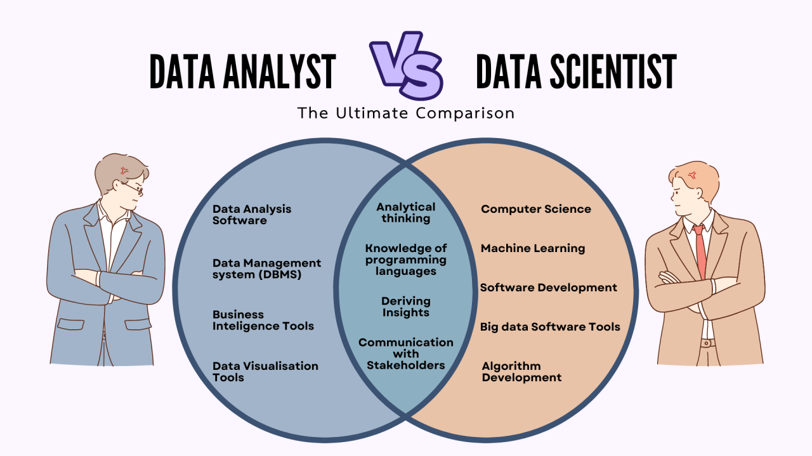

Slide 59
Data Scientist
Building on the work of data analysts, data scientists go a step further by applying advanced analytical models and machine learning techniques to predict future trends and solve complex problems.
They work with both structured and unstructured data, and their role often involves formulating hypotheses, designing experiments, and creating predictive models.
Data scientists bridge the gap between interpreting historical data and generating forward-looking insights.

Slide 60
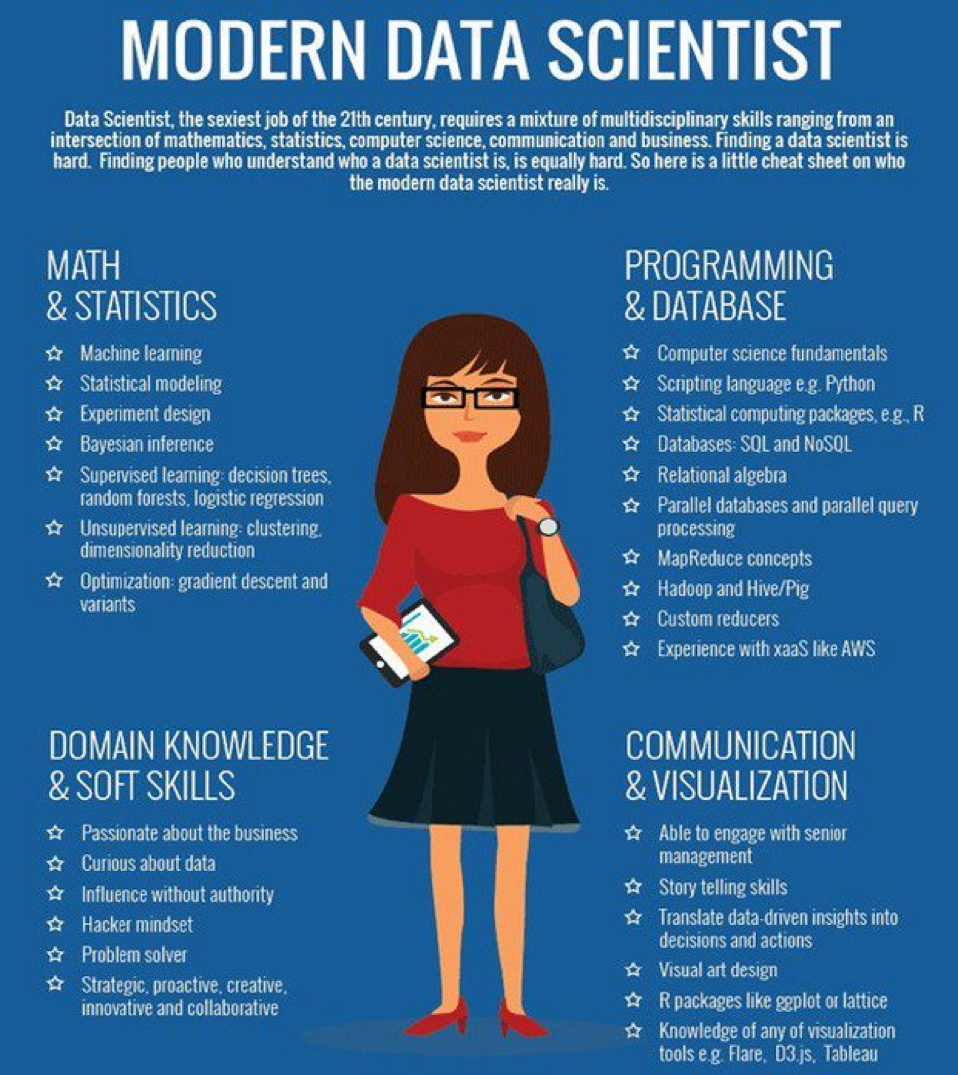

Slide 61
Machine Learning Engineer
Machine learning engineers specialize in operationalizing the models developed by data scientists.
While data scientists focus on research and experimentation, machine learning engineers design, build, and deploy scalable systems that integrate machine learning algorithms into production environments.
They also optimize model performance, manage large-scale datasets, and ensure the systems are reliable and efficient.

Slide 62
Data Engineer
Data engineers provide the foundational infrastructure that supports the entire data life cycle.
They design and manage data pipelines, ensure data quality, and integrate data from various sources.
Their work enables data analysts, data scientists, and machine learning engineers to access reliable, high-quality data for their tasks.
Data engineers are the architects of the data ecosystem, ensuring that data flows seamlessly and is accessible for analysis and modeling.

Slide 63
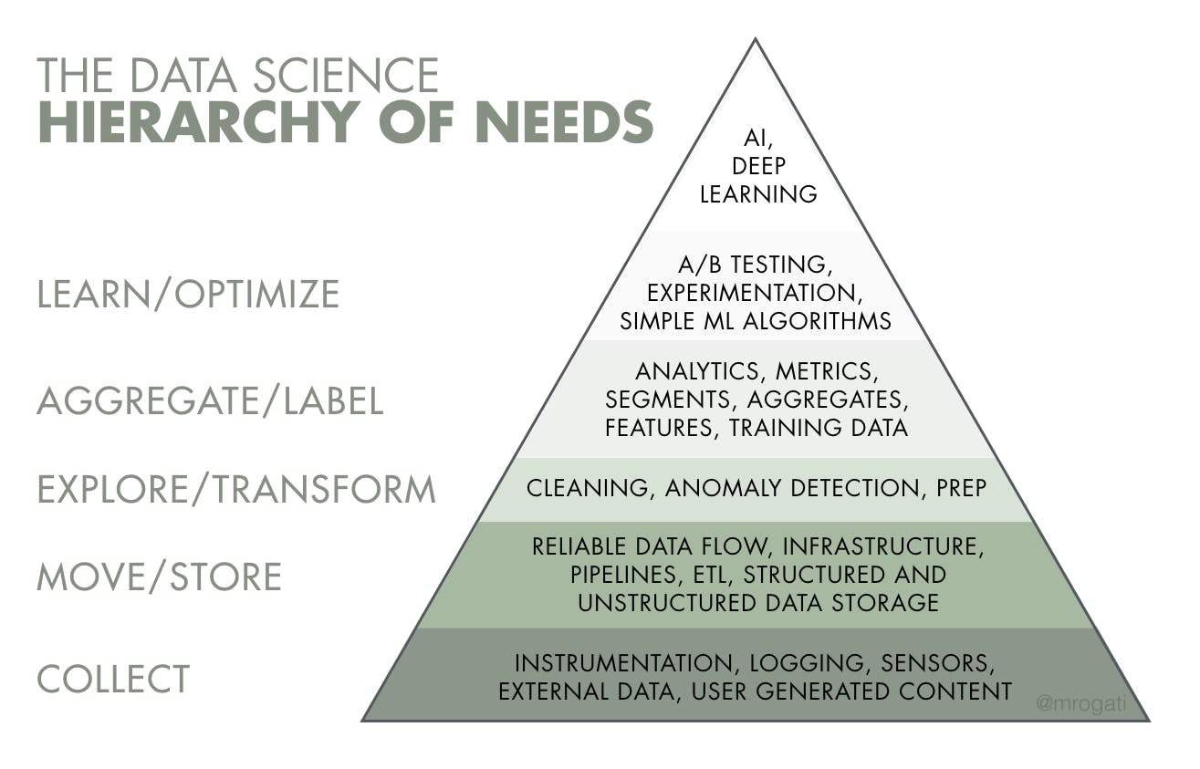

Slide 64
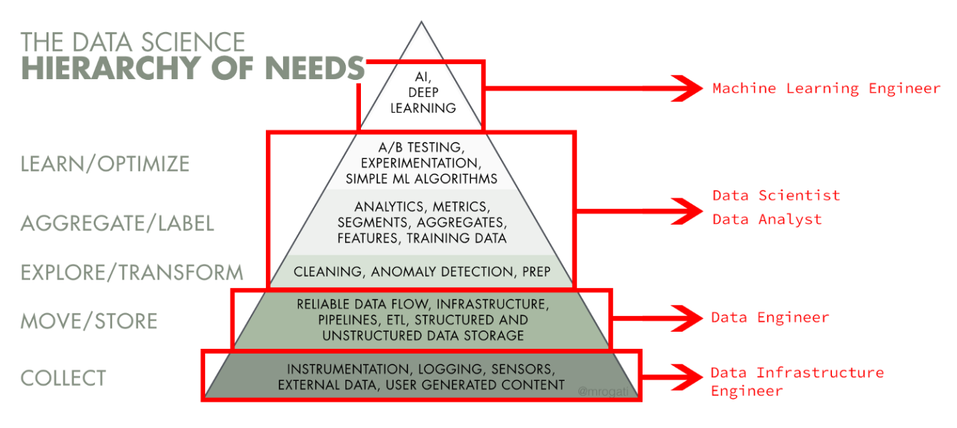

Slide 65
References
https://seas.harvard.edu/news/what-data-science-definition-skills-applications-more

